Slide 1

CSS Flexbox
M3-03
Participate! The more engagement the better! You are NEVER interrupting me!

Slide 2
Objectives
CSS Flexbox

Slide 3
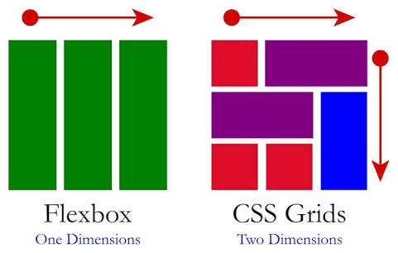
CSS Grid and Flexbox

Slide 4
Flexbox
Flexbox is a CSS3 layout model that is a mobile responsive way to arrange items in a container, using a row-based (single dimension) approach.
Makes positioning child elements easier.
Does not require the use of block, inline, floats, etc..
Makes working with margins/padding easier as Flexbox will arrange items on our behalf, yet give us total control.
We can change order of items without modifying the HTML.

Slide 5
Flexbox
Flexbox also allows us to:
Alter height/width to best make use of any container’s free space.
Built for smaller scale layouts (GRID’s advantage is larger scale layouts)
Flexbox works well with horizontal (inline) or vertical (block) layouts.

Slide 6
Flex Container/Items
Main Start
Main End
Cross Start
Cross Axis
Flex Container (display: flex)
Flex item
Flex item
Flex item
Main Axis
Cross End

Slide 7
flex-direction
This establishes the main-axis, thus defining the direction flex items are placed in the flex container. Flexbox is (aside from optional wrapping) a single-direction layout concept. Think of flex items as primarily laying out either in horizontal rows or vertical columns.
row
column
column-reverse
row-reverse

Slide 8
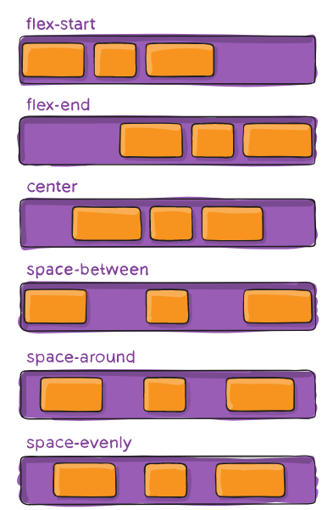
justify-content
Tells the flex container how to layout items on the main axis.
Use these when flex-direction is a ROW

Slide 9
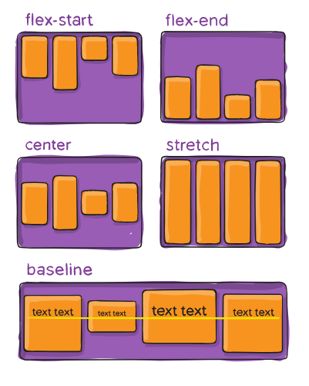
align-items
Tells a flex container how to layout items on the cross axis
Use these when flex-direction is a Column

Slide 10
flex-wrap
Usually Flexbox will try to put all items on one row or column. Setting flex-wrap will tell the flex container that it can wrap the items onto multiple rows or columns.
nowrap (default): all flex items will be on one line
wrap: flex items will wrap onto multiple lines, from top to bottom.
wrap-reverse: flex items will wrap onto multiple lines from bottom to top.

Slide 11
order
Applied to flex items instead of the container.
Flex items are displayed in the same order as they appear in the source document by default. The order property can be used to change this ordering.
.flex-item {
order: 2;
}

Slide 12
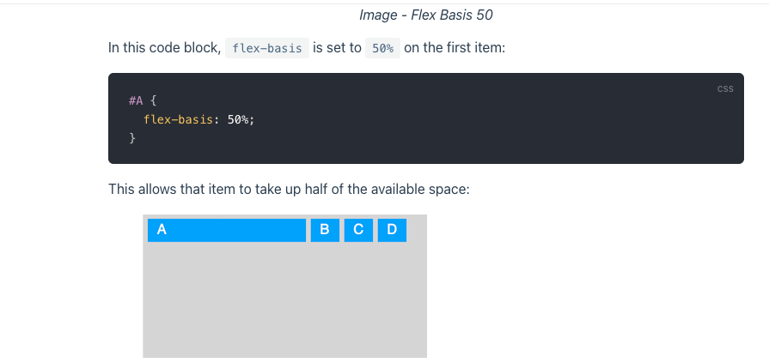
flex-basis
Applied to flex items instead of the container.
It specifies the initial size of the flex item, before any available space is distributed according to the flex factors. When omitted from the flex shorthand, its specified value is the length zero.

Slide 13
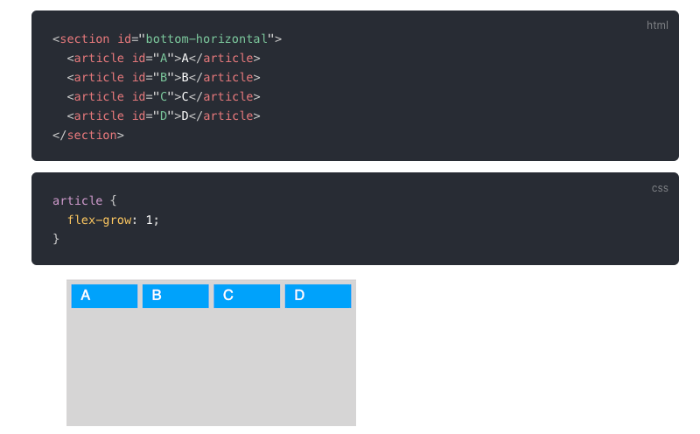
flex-grow
Applied to flex items instead of the container.
It defines the ability for a flex item to grow if necessary. It accepts a unitless value that serves as a proportion. It dictates what amount of the available space inside the flex container the item should take up.
For example, if all items have flex-grow set to 1, every child will set to an equal size inside the container. If you were to give one of the children a value of 2, that child would take up twice as much space as the others.

Slide 14
align-self
Applied to flex items instead of the container.
It makes possible to override the align-items value for specific flex items.
The align-self property accepts the same 5 values as the align-items:
flex-start: cross-start margin edge of the item is placed on the cross-start line
flex-end: cross-end margin edge of the item is placed on the cross-end line
center: item is centered in the cross-axis
baseline: items are aligned such as their baseline are aligned
stretch (default): stretch to fill the container (still respect min-width/max-width)
.flex-item {
align-self: flex-end;
}
justify-self for the main axis is still in development. Would you like to hear more?

Slide 15
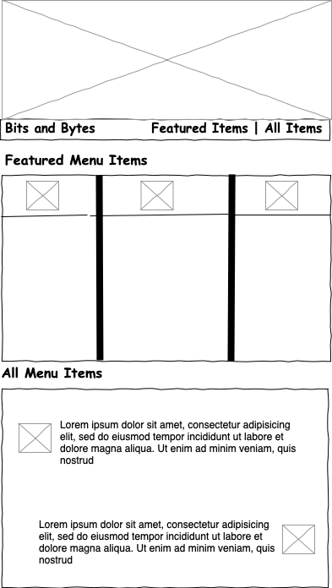
Project Wireframe
A wire frame is rough layout of where items should go on a page.

Slide 16
Flexbox Resources
CSS Tips: Complete Guide Flexbox
Flexbox Froggy (Exercise)
Flexbox Zombies (requires free account)

